Slide 1
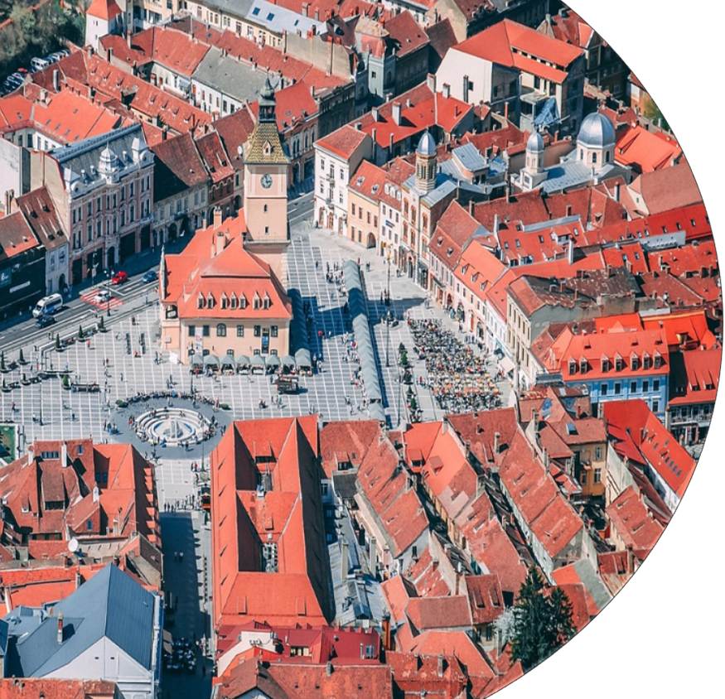
What do you think this is?
What challenges do you think will have been faced when planning and developing this?
What do you think will have been the most difficult challenge to overcome? Why?
Photo be substituted with case study image of ambassador's choice.
Notes:
Have slide on at start for students to look at and think about.
They can discuss this in pairs or groups.
Don’t tell them the answer yet. This is revealed at the end of the session.
Suggested time: 2-5 minutes

Slide 2
Hello …
Who am I?
What is my job?
What does a day in my job look like?
How did I get to where I am today?
What has been my most interesting project?
What am I currently working on?
Notes:
This is an opportunity for you to introduce yourself.
Suggested time: 2-10 minutes

Slide 3

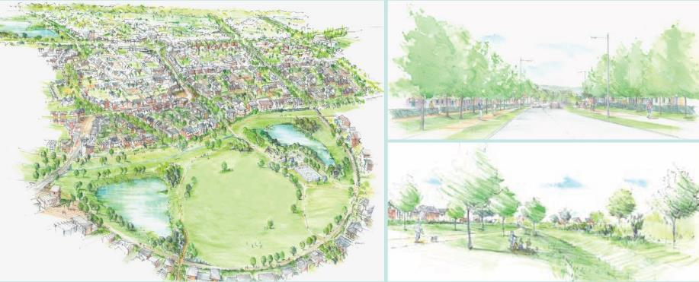
Coming soon …
New development in your area!
Notes:
Introduce the project.
This is a role play - you are the Planner and the students are the stakeholders.
Passionately introduce the idea of a new development coming to their area.
Suggested time: 2-5 minutes

Slide 4

Over to you
A new housing development is needed in your local area.
Members of the RTPI are working on this development.
You are different groups of people with an interest in the project (stakeholders). You need to work with the one of the Planners to make sure your needs and requirements are considered and incorporated in the development.
Notes:
More detail about the development.
Identify yourself as the Planner and the students as the stakeholders.
Suggested time: 2-5 minutes

Slide 5
Stakeholders
In this project, the key stakeholders are:-
Local council - part of the government that makes plans for how to use land and resources to help communities grow in a good way
An environmental group - a team of people who work together to protect nature and make sure animals and plants have safe places to live
Residents' association - is a group of people who live in the same area or building and work together to improve their community and solve problems
Local business owners - people who run shops, restaurants, or other small businesses in a village or town
Notes:
Different stakeholders that have an interest in the new development.
Talk through each of the stakeholders in turn an explain what they are.
Get the students into groups to represent the stakeholders.
Suggested time: 2-10 minutes

Slide 6

Challenges
All projects come with challenges. Let’s look at some challenges that need to be considered for your project today.
Planners must address a range of big challenges faced by the world today.
Another big part of a Planner’s job is consulting with various stakeholders and working together to produce a plan. A range of different opinions and needs must be considered and incorporated into any plan.
Notes:
Challenges faced by planners.
Talk about the different scales of challenges that planners must tackle
Suggested time: 2-5 minutes

Slide 7
Big challenges in the world today
Here are some of the big challenges faced in the world today.
Match up the challenge with the correct definition.
Sustainable energy
Affordable housing
Community wellbeing
Cultural preservation
Climate change mitigation
Biodiversity protection
Homes that people can rent or buy without spending too much money, so they have enough left for other important things.
Using natural resources to make electricity in a way that doesn't harm the planet and can keep working forever.
Taking care of all the different plants, animals, and places on Earth to keep them safe and healthy for the future.
When everyone in an area feels happy, healthy, safe, and supported.
Taking actions to reduce the harmful effects of climate change by using fewer fossil fuels and protecting the environment.
Keeping and celebrating the traditions, stories, and customs of different groups of people so they aren't lost over time.
Notes:
Give these worksheets out now.
The students are to match up the challenge with the correct definition.
Suggested time: 2-10 minutes

Slide 8
Big challenges in the world today
Here are some of the big challenges faced in the world today.
Match up the challenge with the correct definition.
Sustainable energy
Affordable housing
Community wellbeing
Cultural preservation
Climate change mitigation
Biodiversity protection
Using natural resources to make electricity in a way that doesn't harm the planet and can keep working forever.
Homes that people can rent or buy without spending too much money, so they have enough left for other important things.
When everyone in an area feels happy, healthy, safe, and supported.
Keeping and celebrating the traditions, stories, and customs of different groups of people so they aren't lost over time.
Taking actions to reduce the harmful effects of climate change by using fewer fossil fuels and protecting the environment.
Taking care of all the different plants, animals, and places on Earth to keep them safe and healthy for the future.
Notes:
This slide is where the answers are revealed.
Take this opportunity to discuss the challenges in more detail if you have time.
Suggested time: 2-5 minutes

Slide 9
Big challenges in the world today
Sustainable energy
Affordable housing
Community wellbeing
Cultural preservation
Climate change mitigation
Biodiversity protection
Number the big challenges from 1-6 based on which you think is the most important.
(1 = most important 6 = least important)
Which challenge do you think is the most important? Explain why.
Notes:
Evaluation task
Complete section on worksheet
Discussion is time permits
Suggested time: 2-10 minutes

Slide 10
Big challenges tackled by your Planner
What challenges have I worked on in the past?
How have I dealt with these challenges?
How have I had consultations in the past?
What did I discuss?
How have I influenced different people?
Notes:
This is an opportunity for you to talk about your experiences by answering the questions on the slides in relation to your personal experiences.
Suggested time: 2-15 minutes

Slide 11
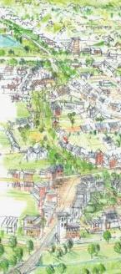
This project
You (the stakeholders) have met with the Planner already and you have outlined some of your thoughts, needs and things for them to consider.
The Planner is now using these points to produce a master plan.
You are eager to see what the other stakeholders have discussed so you have asked the planner for their notes. They have sent you an email with the notes.
Notes:
Leads into a match up of stakeholders to their requirements which will happen on the next slide.
Read out the information as a scenario.
Suggested time: 2-5 minutes

Slide 12
Stakeholder requirements
You have been emailed a list of all the different thoughts of the stakeholders, but the document won’t open properly on your laptop and the formatting is wrong.
You must put them in the correct place so that you know which ideas belong to which stakeholder.
Notes:
Give out the stakeholder requirements match up worksheet.
Complete task
Suggested time: 5 - 15 minutes.

Slide 13
This project
The Planner has produced a master plan. They are coming to meet with you later.
You need to relook at the requirements you set out at your first meeting and think about what else you might want and what is most important to you.
Notes:
Give out the list of stakeholder requirements worksheet. These are now in the correct order.
Students can check their answers to the previous task.
Suggested time: 2-5 minutes

Slide 14
Your requirements
Look at the list of requirements relevant to your stakeholder.
What else do you think needs to be added and considered?
Add these now.
Choose five requirements that you think are the most important.
Justify your decision (why do you think they are the most important).
Notes:
Here you give out the worksheet titled your requirements.
Complete the tasks
Suggested time: 5-15 minutes.

Slide 15
This project
You will now meet with the Planner. They will present their plan to you and the other stakeholders.
They will outline how your requirements have been considered.
Notes:
Introduce the next part of the role play
Suggested time: 1 minutes

Slide 16
Planner presentation
Listen to the Planner’s presentation.
Make notes from their presentation about what they have and haven't considered from your requirements.
Notes:
Tell students to listen and make notes on their worksheet
Suggested time: 1 minutes.

Slide 17
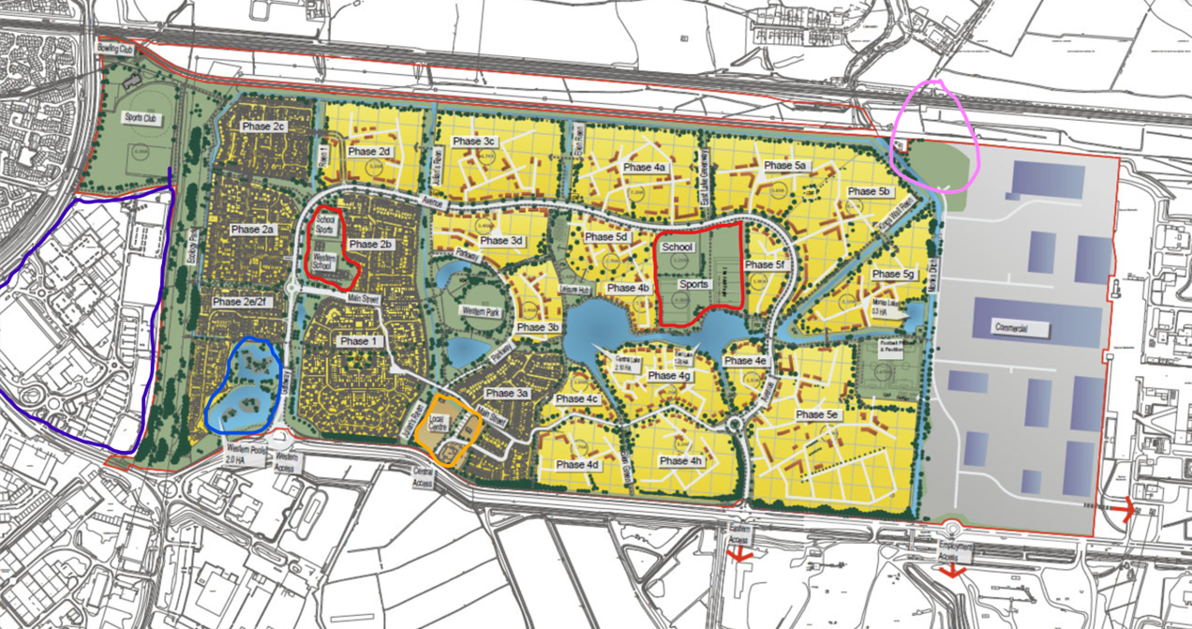
Notes:
This is the master plan for you to present. Key below.
There are worksheets of this with a key for the students to see it closer. Give these out first and then present the plan.
Suggested time: 5-15 minutes
Key:
Yellow = housing (4000 homes, 10% affordable)
Green = parks and open spaces
Dark green = trees
Light blue = lakes
Gold/light brown area with orange outline (bottom centre) = ‘local centre’ comprising pub/restaurant, community centre, doctor’s surgery, shop, café
Grey area with dark blue shapes to right = business park with warehouses and employment uses (the land to the right is the remains of the steelworks, which is still operating)
red outline = new primary schools with sports pitches (pitches are open for community sports clubs to use in evenings)
blue outline = existing lakes. The other lakes are being created as part of the sustainable drainage system to ensure the site doesn’t flood.
pink outline = location of proposed new railway station with park and ride (on the green area). This is the London to Carmarthen mainline.

Slide 18
Planner presentation
Now the presentation is over, discuss with your group what you think of the plan. What else do they need to include or consider?
Make a list of things you want them to change. Explain why these things are important to you.
Notes:
Discussion in their groups about the presentation.
They then make notes on their worksheets
Suggested time: 2-10 minutes.

Slide 19
Stakeholder feedback
In turn, each group of stakeholders will have the opportunity to tell the Planner things you want them to change.
Explain why these things are important to you
Notes:
They each, in turn, tell you their ideas.
Pay close attention as you will be picking a winning group.
End this section still in role and say you will go away and consider their ideas.
Suggested time: 5 - 20 minutes.

Slide 20
Best negotiations
Prize giving for the team who negotiated and communicated the needs of their stakeholders the best.
Notes:
This is the end of the role play and an opportunity for you to reward the best team.
Suggested time: 2-5 minutes.

Slide 21
What makes a good planner?
Here are some of the key skills that a Planner must have.
Match up the skill with the correct definition.
Thinking skills
Technical skills
People skills
Project management
Law knowledge
Research skills
Adaptability
Ethical judgement
Flexibility: Changing plans when needed.
Innovation: Using new ideas and technologies in plans.
Market Research: Studying trends to know what people need and want.
Policy Analysis: Checking how rules affect communities.
Zoning Laws: Knowing rules about how land can be used.
Environmental Laws: Understanding laws that protect nature.
Data Understanding: Being good at looking at numbers and facts to make smart choices.
Problem-Solving: Finding solutions to problems like traffic jams or not enough houses.
Maps and Computers: Using maps and special computer programs to see and plan areas.
Design: Knowing how to design nice-looking and useful places.
Integrity: Being honest and fair in planning.
Equity: Making sure everyone is treated fairly in community development.
Public Speaking: Talking clearly to groups of people about your plans.
Negotiation: Helping people agree on the best solutions.
Time Management: Handling several tasks and finishing them on time.
Budgeting: Planning how to spend money wisely on projects.
Notes:
Give these worksheets out now.
The students are to match up the challenge with the correct definition.
Suggested time: 2-10 minutes

Slide 22
What makes a good planner?
Here are some of the key skills that a Planner must have.
Match up the skill with the correct definition.
Thinking skills
Technical skills
People skills
Project management
Law knowledge
Research skills
Adaptability
Ethical judgement
Data Understanding: Being good at looking at numbers and facts to make smart choices.
Problem-Solving: Finding solutions to problems like traffic jams or not enough houses.
Maps and Computers: Using maps and special computer programs to see and plan areas.
Design: Knowing how to design nice-looking and useful places.
Public Speaking: Talking clearly to groups of people about your plans.
Negotiation: Helping people agree on the best solutions.
Time Management: Handling several tasks and finishing them on time.
Budgeting: Planning how to spend money wisely on projects.
Zoning Laws: Knowing rules about how land can be used.
Environmental Laws: Understanding laws that protect nature.
Market Research: Studying trends to know what people need and want.
Policy Analysis: Checking how rules affect communities.
Flexibility: Changing plans when needed.
Innovation: Using new ideas and technologies in plans.
Integrity: Being honest and fair in planning.
Equity: Making sure everyone is treated fairly in community development.
Notes:
This slide is where the answers are revealed.
Take this opportunity to discuss the skills in more detail if you have time.
Suggested time: 2-5 minutes

Slide 23
What makes a good planner?
Thinking skills
Technical skills
People skills
Project management
Law knowledge
Research skills
Adaptability
Ethical judgement
Choose three skills that you think are the most important for a Planner to have.
Explain why these are important skills.
Notes:
Evaluation task
Complete section on worksheet
Discussion is time permits
Suggested time: 2-10 minutes

Slide 24
This is….
one of my projects.
Now what challenges do you think will have been faced when planning and developing this?
Now what do you think will have been the most difficult challenge to overcome? Why?
Photo be substituted with case study image of ambassador's choice.
Notes:
Finally, you reveal your project.
Suggested time: 2-15 minutes

