Slide 1
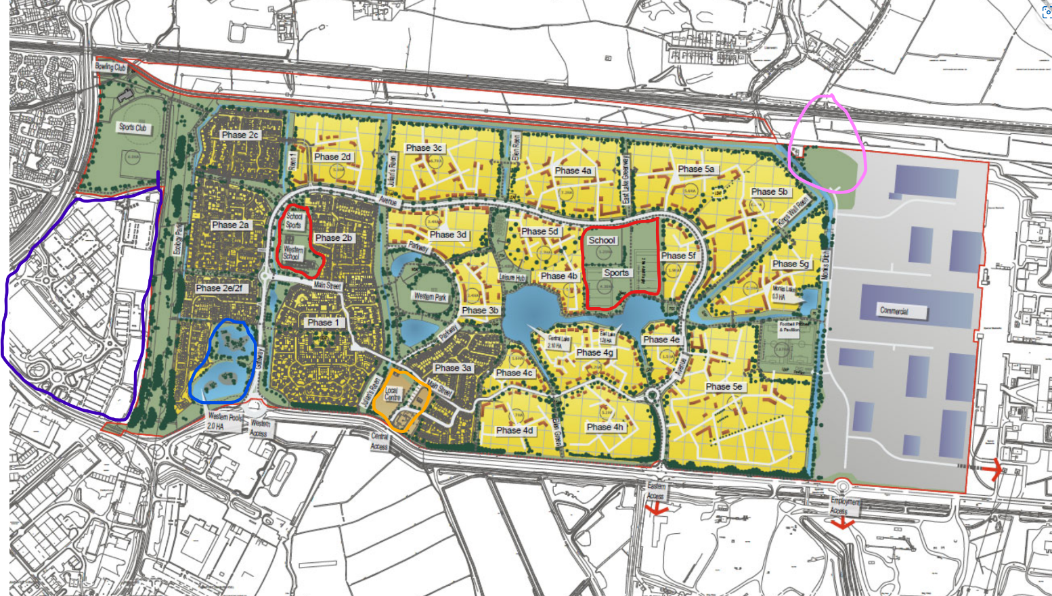
Master plan

Slide 2








Master plan key
 | Yellow - housing (4000 homes, 10% affordable)
 | Green - parks and open spaces
 | Dark green - trees
 | Light blue = lakes
 | Gold/light brown area with orange outline (bottom centre) = ‘local centre’ comprising pub/restaurant, community centre, doctor’s surgery, shop, café
 | Grey area with dark blue shapes to right = business park with warehouses and employment uses (the land to the right is the remains of the steelworks, which is still operating)
 | red outline = new primary schools with sports pitches (pitches are open for community sports clubs to use in evenings)
 | blue outline = existing lakes. The other lakes are being created as part of the sustainable drainage system to ensure the site doesn’t flood.
 | pink outline = location of proposed new railway station with park and ride (on the green area). This is the London to Carmarthen mainline

