Slide 1

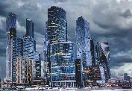
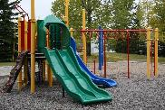
RTPI – Your dream town
Live This is where people have their homes and things they need to survive. _______________ _______________ _______________ _______________ _______________ _______________ _______________ _______________ _______________ _______________ | Work This is what people need to do their jobs such as a place to go and ways to get there. _________________ _______________ _______________ _______________ _______________ _______________ _______________ _______________ _______________ _______________ | Play These are leisure places like parks, playgrounds, and fun spots where people relax or play. _________________ _______________ _______________ _______________ _______________ _______________ _______________ _______________ _______________ _______________
Your dream town - a summary 1.______________________________________________________________________________________________________________________________________________________________________________________________________________________________________________________________________________________ 2.______________________________________________________________________________________________________________________________________________________________________________________________________________________________________________________________________________________________________________________________________________ 3.______________________________________________________________________________________________________________________________________________________________________ ________________________________________________________________________________________________________________

